Slide 1
Frequency Division Multiplexing
Parshuram Sharma

Slide 2
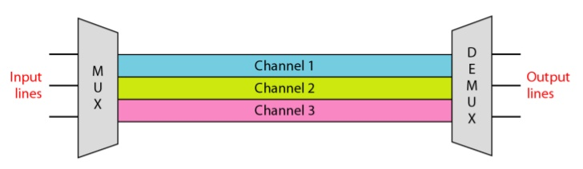
Frequency Division Multiplexing
It is based on sharing the available bandwidth of a communication channel among the signals to be transmitted.
A FDM operates in a similar way to radio broadcasting where a number of different stations will broadcast simultaneously but on different frequencies.
People can then “tune” their radio so that it capture the frequency or station they want

Slide 3
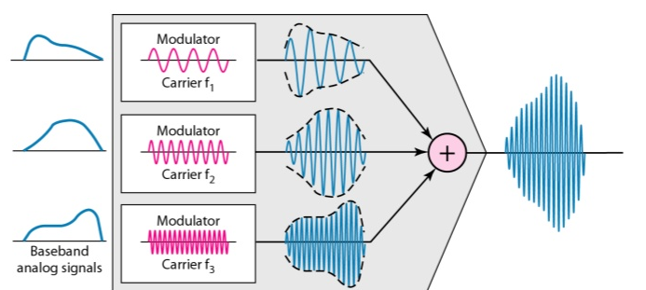
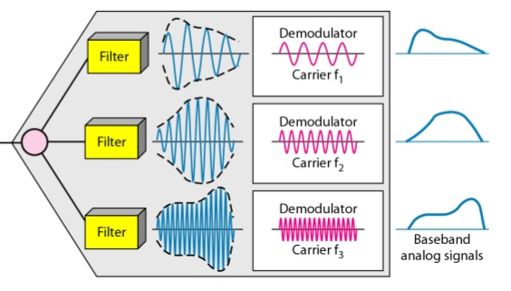
FDM Process
FDM demultiplexing

Slide 4
There are some advantages of frequency division multiplexing(FDM) which are
It does not need synchronization between its transmitter and receiver.
Frequency division multiplexing (FDM) is simpler and easy demodulation.
Due to slow narrow band fading only one channel gets affected.
It is used for analog signals.
A large number of signals (channels) can be transmitted simultaneously.

Slide 5
There are some disadvantages of frequency division multiplexing (FDM) which are:
It is suffers problem of cross-talk.
It is used only when a few low speed channels are desired.
Intermodulation distortion takes place.
The communication channel must have a very large bandwidth
A large number of modulators and filters are requird

Slide 6
Applications:
It is used to public telephones and in cable TV systems.
It is used in broad casting.
It is used in AM and FM broadcasting.

